Slide 1

Cerebral infraction (Stroke) Early Detection
Authors: Roy Zarum, Or Segal
and Adi Ben Zur
Advisors: Prop. Adi Shraibman, Dr. Dorit Shweiki, Dr. Yonatan Bilu
Project Number: 15005914

Slide 2

Research Question
Cerebral infarction can often occur without any noticeable symptoms, even in individuals who appear to be healthy.
Our aims and objectives:
Search and identify important lifestyle risk factors associated with Cerebral Infraction occurrence.
Develop a machine learning model capable of predicting stroke.

Slide 3
Introduction
Cerebral infarction (CI), also known as stroke, is a serious medical condition caused by the interruption of blood flow to the brain.
CI is resulting a lack of oxygen and nutrients that often leads to severe disability or death.
In 2019 stroke has been the second leading cause of death in the world, responsible for 11% of worldwide deaths.

Slide 4
The Process
Understand the data and select relevant features
Perform data cleaning and preprocessing
Select appropriate machine learning model
Train the selected models
Analyze the results

Slide 5
Data Fields
Physiological
Sex
Year of birth
BMI
Blood pressure
Pulse rate
Behavioral
Smoking status
Diets and meals
Sleeping habits
Alcohol intake
Sun exposure
Sports habits
Mental status
Demographic
Ethnic background
Skin and hair color
Environmental
Close to major road
Exposure to air pollution
Maternal smoking around birth

Slide 6
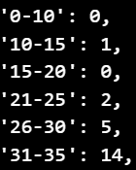
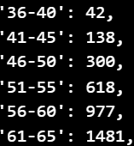
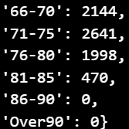
Data Exploration
From 500,000 UK Biobank participants 10831 had CI. 9420 participants had CI after recruited to UK Biobank .
Ages CI recorded:
Out of the individuals diagnosed with cerebral infarction, 4,270 (39.42%) were women and 6,561 (60.58%) were men.
Death causes 420.

Slide 7

Data split
UK Biobank
500,000
Participants
226
data fields chosen
40,000
Control group
9420 had CI cases
116 Data Fields with maximum 0f 20% missing-values

Slide 8
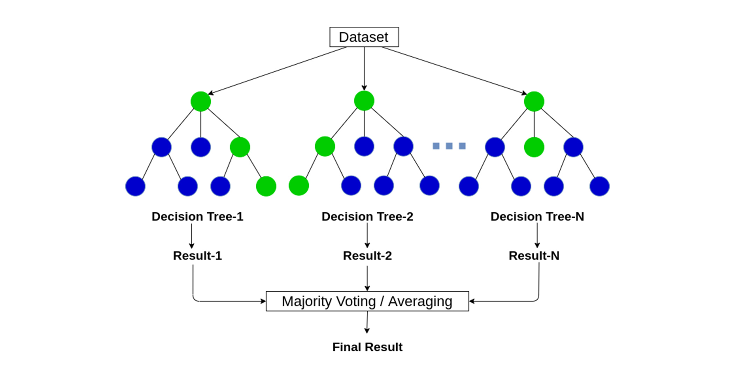
Model selection
Random Forest
XGBoost
Ensemble learning method that builds multiple decision trees and combines their predictions to improve accuracy and reduce overfitting.
A powerful gradient boosting algorithm that builds an ensemble of decision trees, optimizing for speed and accuracy by iteratively improving predictions through minimizing errors in a highly efficient manner.

Slide 9
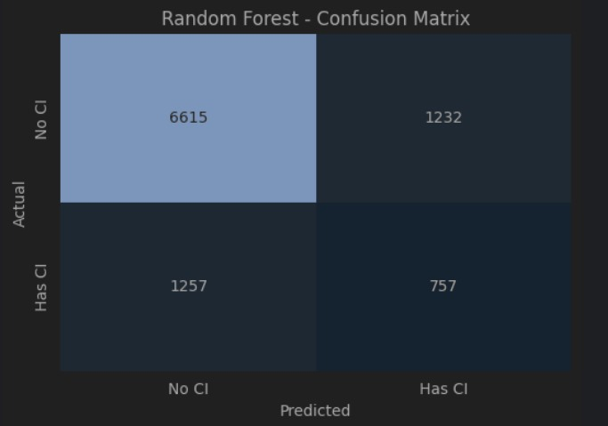
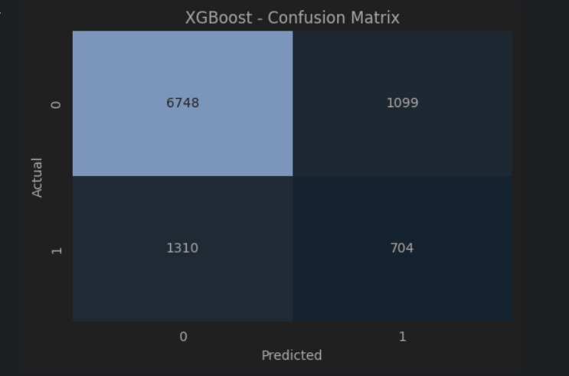
Models' evaluation- Confusion matrixes

Slide 10
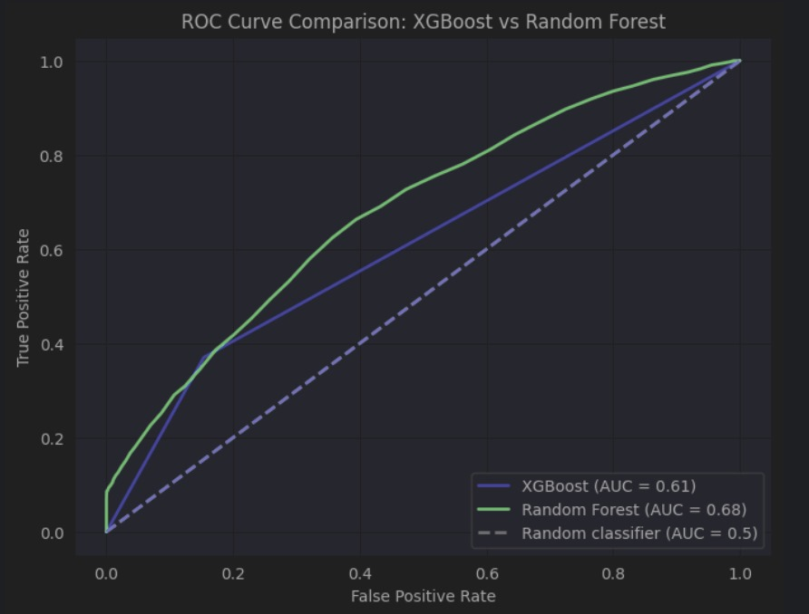
Models' evaluation – ROC Curve

Slide 11
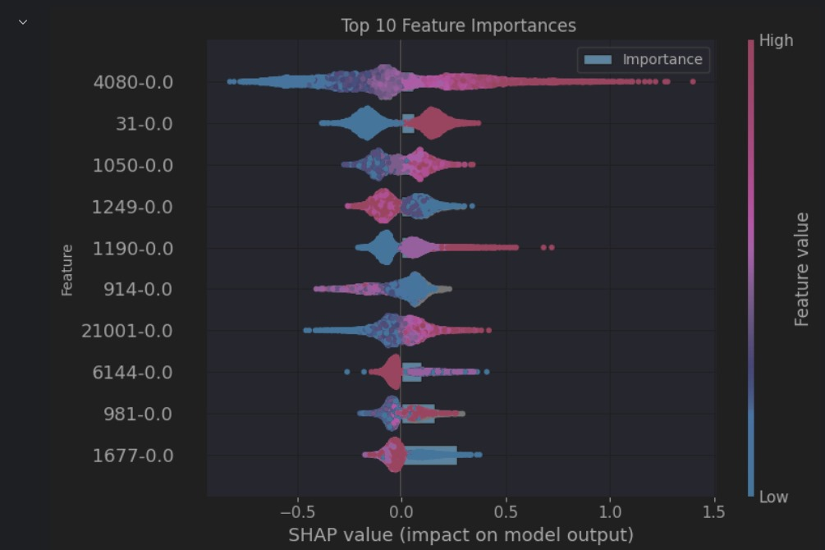
Models' evaluation – Important features
Systolic blood pressure
Sex
Sun Exposure
Past tobacco smoking
Nap during day
Vigorous physical activity
BMI
Eggs, meat, sugar intake
Walking time
Breastfed as a baby

